Slide 1

Bright TV

Slide 2
Table of Content
Miro Planning…………………………………………....3
SQL Explanation………………………………………...5
Google Looker Dashboard..…………………….….6
Recommendations……………………………………11

Slide 3
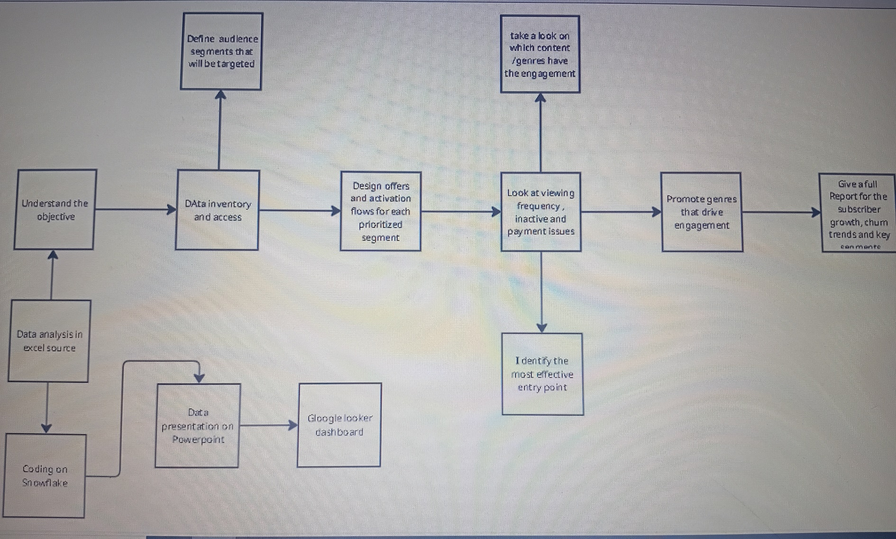
Miro Planning

Slide 4
The above workflow ensures we leverage data to segment our audience, design effective offers, optimize engagement through content, and report on growth and churn trends to guide business decision.
Data foundation we begin by understanding the business objective, coding in snowflake, analyzing data on Excel. Insights are visualized via Powerpoint and Google looker Dashboard.
Content focus we review which genres or content generate the most engagement and promote those genres strategically.

Slide 5
SQL Explanation
Our code transforms raw viewing logs into actionable insights about customers.
Who they are (Demographics and Age buckets)
How they behave( frequently, day/month patterns, sessions length)
This helps leadership track subscriber engagement , churn risk and growth opportunities in a clear and structured way.

Slide 6
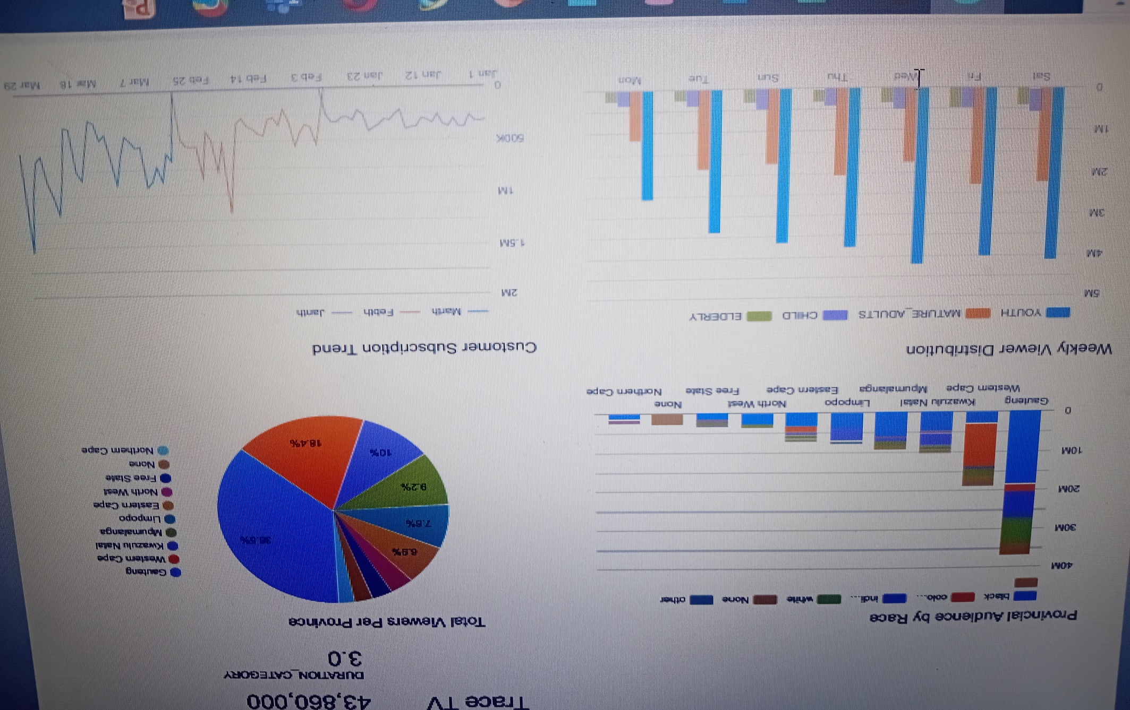
Google Looker Dashboard

Slide 7
Provincial Audience by Race
This chart shows the racial breakdown of our viewers across provinces.
Gauteng is the powerhouse market both in size and diversity, contributing the majority of total viewership.
Western Cape and KZN are our secondary hubs, with significant racial diversity and growth potential.
Our content appeals across all race groups national, but focusing on Gauteng, Western Cape and KZN will maximize impact.

Slide 8
Weekly Viewer Distribution
Youth and Mature Adults dominate viewing across all days.
Weekends show the highest engagement
Children and Elderly are smaller but consistent audiences.
Focus content and marketing on YOUTH and Adults with premium content release on weekends.

Slide 9
Customer Subscription Trend
Subscription grew steady in Jan and Feb.
Strong spike in march, showing accelerated traction, likely from campaigns or popular content.
Growth momentum is strong, march`s spike proves we can scale further with the right promotions.

Slide 10
Total viewers per province
Gauteng , WC and KZN are still dominating the market, this tells us that these Provinces should be our first priority to maximize the company`s gaol then other provinces are still growing meaning we have to keep atracting them to have more views on our channels

Slide 11
Recommendations
Prioritize core provinces: focus campaigns in Gauteng, WC and KZN
Deliver tailored content for youth and Mature Adults, our largest and most engaged groups.
Launch new shows and promotions on Friday and Saturday when engagement peaks
Replicate march`s subscription spike with regular monthly promotions and exclusive content drops.

